Slide 1
REAL - TIME OBJECT DETECTION USING YOLO-V10 (COMPUTER VISION)
Under the Esteemed Guidance of
Ms. AKULA THULASI M.Tech,
Assistant Professor
Presented By
KANDA NAGA SANDHYA
23JN1DAH11
KAKINADA INSTITUTE OF ENGINEERING & TECHNOLOGY
FOR WOMEN DEPARTMENT OF CSE
ARTIFICAL INTELLIGENCE & DATA SCIENCE

Slide 2
List of contents
Abstract
Introduction
Literature survey
Existing methodologies
Proposed Methods
Applications
Results
Evaluation metrics
Conclusion
Future scope
Queries
Thank you

Slide 3
Abstract
Object Detection is a key area in computer vision with applications in many fields such as surveillance, autonomous vehicles, retail analytics, robotics, and smart city solutions. This project presents a practical and efficient approach to object detection using the latest version of the YOLO (You Only Look Once) model — YOLO v10. YOLO is a popular deep learning algorithm known for its ability to detect multiple objects in a single pass, ensuring real-time performance and high accuracy. The system uses Convolutional Neural Networks (CNNs) to detect and classify objects from various sources including images, pre-recorded videos, and live camera feeds. YOLO v10 builds on the strengths of earlier versions by improving both speed and precision, making it suitable for real-world scenarios where quick and accurate decision-making is required. The architecture of YOLO v10 is designed to handle challenges such as varying object sizes, overlapping objects, cluttered backgrounds, and different lighting or weather conditions. The model is trained on large datasets containing thousands of labeled images, enabling it to recognize a wide variety of objects. The detection pipeline includes stages such as data preprocessing, feature extraction, bounding box prediction, classification, and non-max suppression to eliminate duplicate results. One of the key advantages of YOLO v10 is its ability to detect and localize multiple objects in a single frame, reducing computational overhead and processing time. This project aims to demonstrate how YOLO v10 can be integrated into real-time applications like surveillance monitoring, traffic management, object tracking, and safety alert systems, ultimately showcasing how modern deep learning models can bring speed, intelligence, and efficiency to computer vision tasks.
.

Slide 4
Introduction
In today’s fast-moving world, the need for real-time object recognition is more important than ever — from ensuring public safety to enabling smarter automation. This presentation explores a practical and efficient solution: an intelligent object detection system powered by YOLOv10. By combining the speed and accuracy of deep learning with a user-friendly Gradio interface, our project detects objects in images, videos, and live streams — making real-time AI both accessible and impactful.
Key Points to Cover:-
Why YOLOv10
The Power of Convolutional Neural Networks (CNNs) :- Provide a high-level overview of CNNs and their effectiveness in image recognition tasks.

Slide 5
Why This Project?
Real-Time Detection is Essential – Enables automation in smart cities, traffic control, and surveillance.
Existing Systems Have Limitations – Many current solutions are slow and not user-friendly.
Need for a User-Centric Solution – Aims to provide an easy-to-use interface for all users.
YOLOv10 as the Core Technology – Delivers high accuracy and speed in object detection.
Gradio for Seamless Interaction – Offers a no-code, interactive UI to test the model.
Versatility Across Applications – Can be used for videos, live feeds, and images.
Scalable and Lightweight Design – Runs on moderate systems without heavy setup.
Foundation for Future Projects – Opens up possibilities for extended smart solutions.

Slide 6
Technologies Used
YOLOv10 – Pre-trained deep learning model for fast and accurate object detection.
Gradio – Python library used to build an interactive UI for model testing.
OpenCV (cv2) – For handling image/video processing and real-time frame capture.
Python – Core programming language used for backend logic and integration.
Tempfile – Manages temporary file storage for uploaded videos/images.
NumPy – Supports numerical operations and array processing in Python.
VS Code– For testing and debugging code during development.
Ultralytics Library – Provides easy access to YOLO models and prediction APIs.

Slide 7
Literature survey
Object detection is a crucial task in computer vision that involves identifying objects and determining their locations within an image or video. YOLO (You Only Look Once) is one of the most popular and efficient object detection algorithms due to its real-time performance and high accuracy.
Object Detection with YOLO
YOLO treats object detection as a regression task, predicting class probabilities and bounding boxes in a single evaluation.
The original YOLO model uses a single neural network that divides the image into grids to detect objects.
YOLOv3 to YOLOv5 improved accuracy, speed, and usability, with YOLOv5 widely used for custom tasks via PyTorch.
YOLOv7 and YOLOv8 added attention mechanisms and anchor-free heads for better dense detection and tracking.
YOLOv10 focuses on lightweight deployment, fewer parameters, and high-speed detection on edge devices.
YOLO is applied in traffic monitoring, healthcare, face detection, autonomous vehicles, and industry automation.
YOLO's low inference time and end-to-end training make it ideal for real-time applications.
YOLO is often integrated with models like transformers and LSTMs for advanced scene and temporal detection.

Slide 8
Implementation
Libraries: Cv2,Matplotlib.pyplot,Numpy,TensorFlow, Sklearn.metrics, Tensorflow.keras.layers
Data Preprocessing: Grab images, locate license plates, and clean them up for the CNN.
CNN Model: Train a powerful CNN to recognize characters using a labeled dataset.
ITMS Integration: Process live video, recognize plates in real-time, and manage the data for ITMS applications.
Evaluation & Improvement: Test thoroughly and fine-tune the system for optimal performance.

Slide 9
Model Integration and Backend
Role: Handles loading and running the pre-trained YOLOv10 model
Responsibilities:-
Manage image/video input processing and prediction
Optimize model usage for speed and accuracy
Handle confidence threshold and image size logic
Implement error handling for unsupported input types
Ensure smooth switching between image and video input modes
Support dynamic model selection (n/s/m/b/l/x versions of YOLOv10)
Automate video frame reading and annotation
Configure output generation for annotated video/image

Slide 10
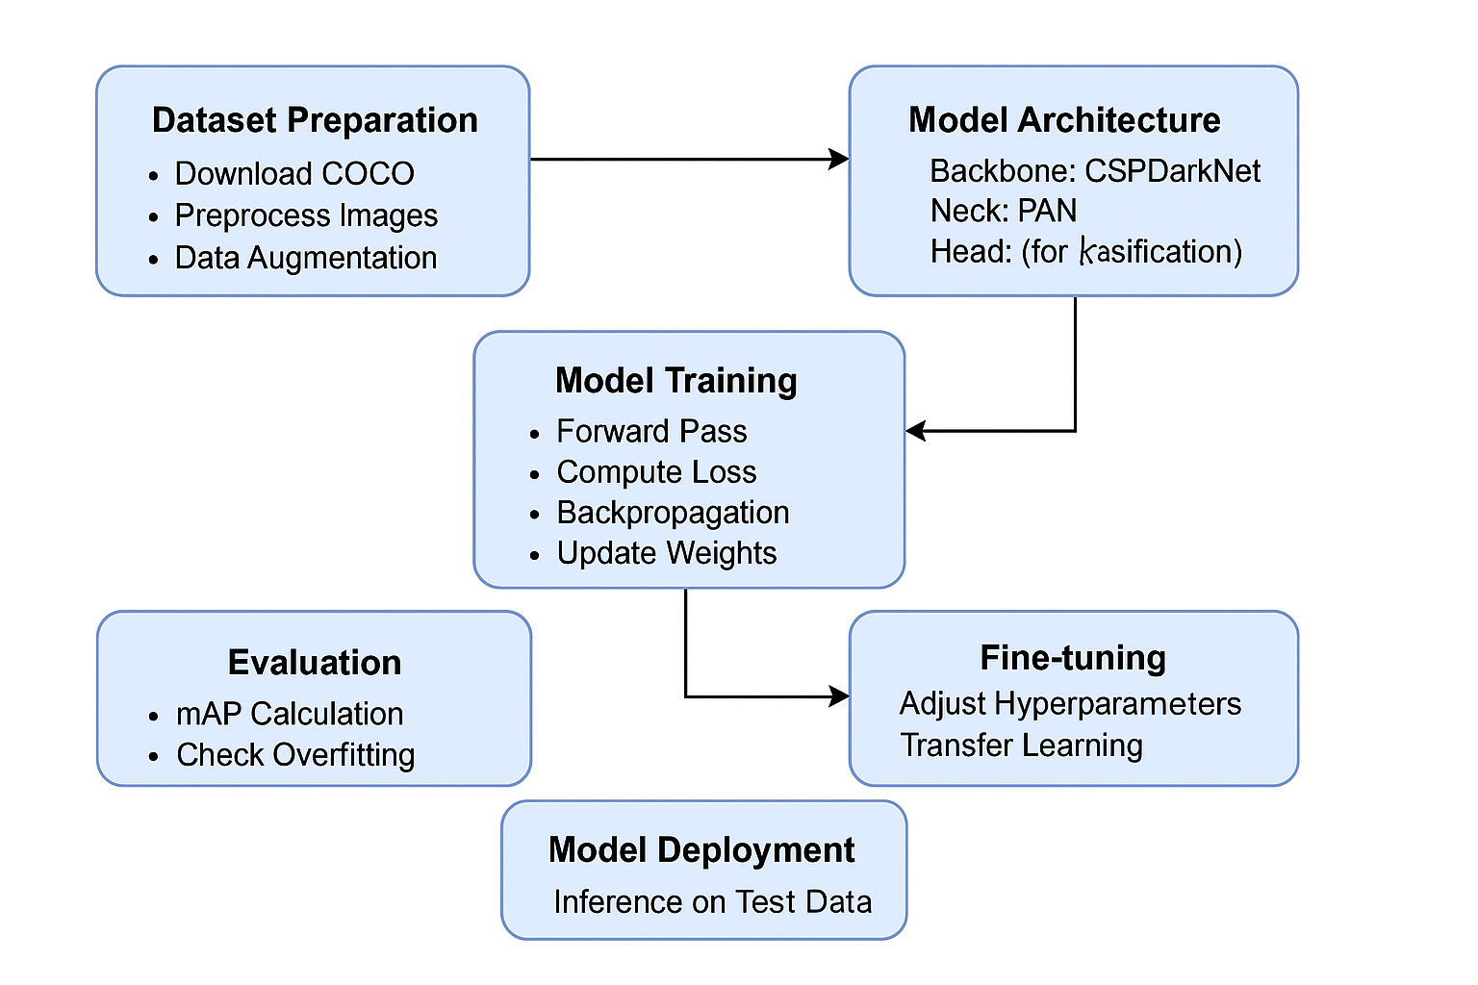
Dataset
Dataset training flowchart

Slide 11
Implementation
Libraries: Ultralytics, OpenCV, Gradio and Tempfile. Data Preparation: Resize images, annotate objects, apply augmentations. Model Training: Train YOLOv10 with labelled data, optimize loss. Real-Time Inference: Detect objects in images, videos, or webcam streams. Evaluation & Optimization: Use Threshold - to filter out low-confidence predictions.

Slide 12
Existing Method
YOLOv10:-
YOLOv10 (You Only Look Once version 10) is a state-of-the-art, real-time object detection model based on Convolutional Neural Networks (CNNs). It performs both classification and localization tasks in a single pass, making it highly efficient and fast. YOLOv10 is known for its speed, allowing for real-time object detection in both images and video. The model predicts bounding boxes and class labels for multiple objects in an image simultaneously, making it suitable for dynamic applications. With improvements in accuracy and speed over previous versions, YOLOv10 continues to be widely used in applications like autonomous driving, security, and video surveillance.

Slide 13
Frontend and Gradio UI
Role: Designs and manages the Gradio-based interface
Responsibilities:
Develop the user interface using Gradio Blocks and Components
Handle visibility toggling between Image and Video inputs
Style the app for better usability, responsiveness, and user flow
Add useful UI elements like GitHub, Arxiv links, project title, and credits
Implement sliders and dropdowns for model configuration (confidence, image size, model variant)
Ensure clean layout using Gradio’s Column and Row blocks
Integrate example inputs for easy demo/testing
Collaborate with the backend lead to connect UI inputs with inference logic

Slide 14
Evaluation metrics
Accuracy:
This is the most common metric, representing the percentage of license plates correctly recognized by the system. It's calculated as the number of correctly recognized plates divided by the total number of plates.
Precision:
Precision measures the proportion of plates identified as specific characters that actually belong to those characters. It helps identify if the system is making many false positives.
Character Error Rate (CER):
This metric calculates the percentage of individual characters that are incorrectly recognized by the system. A lower CER indicates better character recognition accuracy.

Slide 15
Conclusion
The integration of Convolutional Neural Networks (CNNs) for License Plate Recognition (LPR) presents a transformative approach to Intelligent Traffic Management Systems (ITMS). This technology offers significant potential for:
Improved Traffic Flow: Real-time data from LPR empowers dynamic traffic signal adjustments, leading to smoother traffic flow and reduced congestion.
Enhanced Safety and Security: Automatic detection of stolen vehicles and traffic violations promotes public safety. Accident investigation is also aided by tracking vehicle movements.
Increased Efficiency: LPR facilitates automatic toll collection and streamlines parking management, benefiting both drivers and authorities.
Data-driven Insights: LPR data analysis provides valuable insights into traffic patterns, enabling informed planning and infrastructure development.

Slide 16
Future scope
The future of Intelligent Traffic Management Systems (ITMS) with CNN-based License Plate Recognition (LPR) is brimming with exciting possibilities. We can expect real-time tracking of specific vehicles, allowing for improved response times in emergencies and better enforcement of traffic violations. By fusing LPR data with other sensors, the system will gain a more comprehensive view of the traffic environment, enabling robust object detection in any weather condition. Advanced machine learning models will leverage LPR data to predict traffic patterns and congestion, facilitating proactive management strategies. Furthermore, LPR data will be instrumental in the seamless integration of autonomous vehicles with the ITMS infrastructure. Beyond these technological advancements, standardization and clear privacy regulations will be crucial for ensuring interoperability between systems and responsible data usage. In essence, CNN-based LPR is poised to propel traffic management into a new era, characterized by increased efficiency, safety, and a data-driven approach to creating a smarter and smoother transportation experience for all.

Slide 17


